Slide 1
Divide and Conquer: On towards Micro Services

Slide 2
Who am I?
I am Gaurav
I work on:
- Philips Wellcentive Data Management Platform
- Docker, Azure DevOps
What drove me to learn about microservices?
- Rise of technologies that are good at small tasks, namely Python, Node.js, etc.
- Cloud Native computing is the soul of most internet as we see it today.
- What looks a big chunk is actually a couple of finely granulated services working together.

Slide 3
Session outline
Expectation from the session.
Evolution of Software.
WHATs and WHENs of Microservices.
Who all have adapted to Microservices?
What really are they ways to achieve them?
HOWs of Microservices.
What are the challenges?
Q & A
Demos and Examples.

Slide 4
What to expect from this session?
At the end of this session, the attendees will be able to:
- Understand what microservices are and how they make life better (Or tougher?)
- Understand various ways to achieve microservices.
- Understand the trend of granularity in software.
- Identify the requirements and evaluate the outcomes of microservices.

Slide 5
Software.. how it has been.
Software has become more intricate compared to how it was earlier. The numbers of users have increased, hence the complexity was undeniable.
With humongous demand, the supply could not be served with or contained within a single gigantic code base. Other reasons were slower delivery, dependencies, tight coupling, etc.
In early 2000s, software practitioners worked around with various architectural patterns and SOA started coming into picture.
SOAs slowly transitioned into hundreds of small independent services, these services are what we know today as microservices.

Slide 6
Um, okay.. but what’s SOA?
Service-oriented architecture (SOA) is a style of software design where services are provided to the other components by application components, through a communication protocol over a network.
These are the 4 characteristics of a service in SOA:
It logically represents a business activity with a specified outcome.
It is self-contained.
It is a black box for its consumers.
It may consist of other underlying services.
Source: Wikipedia

Slide 7
That’s great, but what do I get from using SOA?
Business value is given more importance than technical strategy.
Strategic goals are given more importance than project-specific benefits.
Intrinsic inter-operability is given more importance than custom integration.
Shared services are given more importance than specific-purpose implementations.
Flexibility is given more importance than optimization.
Evolutionary refinement is given more importance than pursuit of initial perfection.
Source: Wikipedia

Slide 8
But we were here for a session on microservices, what is this?
Microservices are a fine grained version of SOA.
Microservices are loosely coupled and independent of each other.
Microservices are small (potentially and very often a process).
Several independent microservices work together to perform a bigger task.
Microservices are independently deployable.
Microservices enable software to be horizontally scalable with ease.
Microservices help in decentralizing continuous delivery.

Slide 9
Oh, where did the they come from?
“Microservices”, the term, was coined in 2011 in a workshop of Software Architects in Venice.
Microservices are inspired by Unix’s idea of loose-coupling and way of working, “Do one thing and do it well”.
Although industry was using them for quite long, the development teams at Netflix brought the idea of “finely grained SOA” to a wider crowd.
Dr. Peter Rodgers introduced the term "Micro-Web-Services" during a presentation at the Web Services Edge conference in 2005.

Slide 10

Who all have adapted to Microservices?

Slide 11
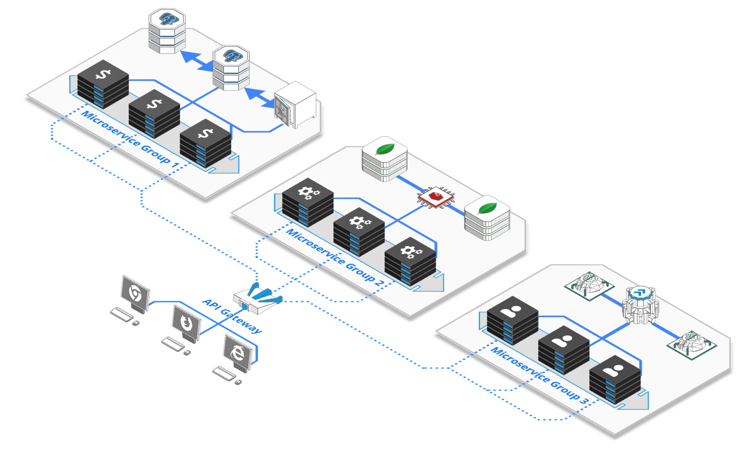
They can be done in various ways - API Gateway
Source: Arcentry.com

Slide 12
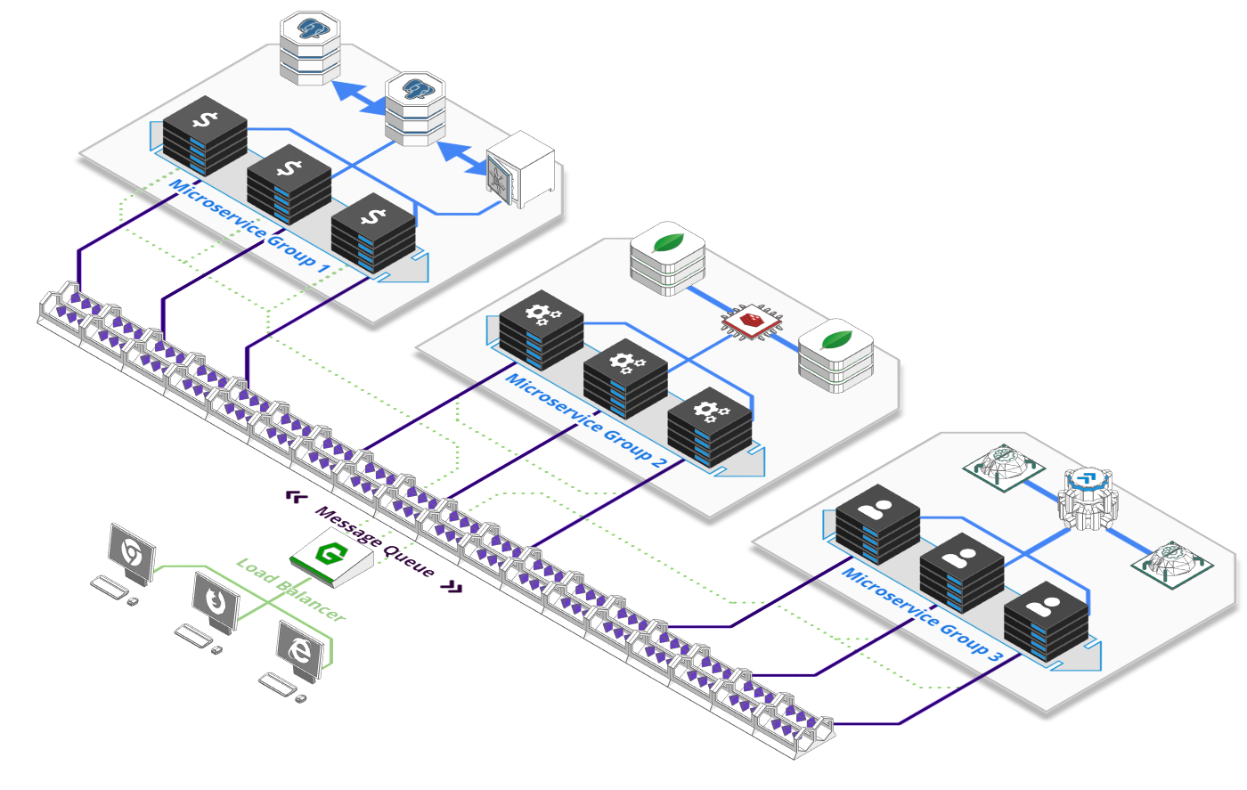
They can be done in various ways – Message Queue
Source: Arcentry.com

Slide 13
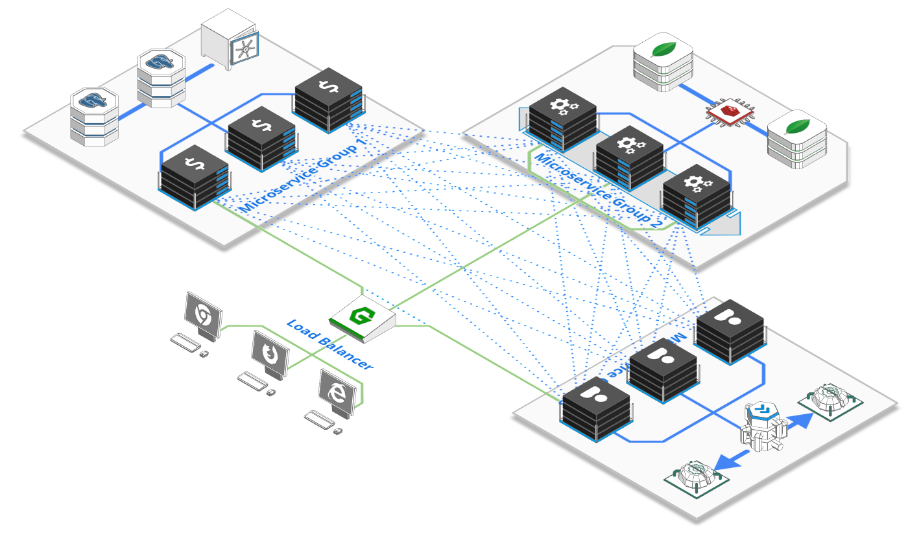
They can be done in various ways – Service mesh
Source: Arcentry.com

Slide 14
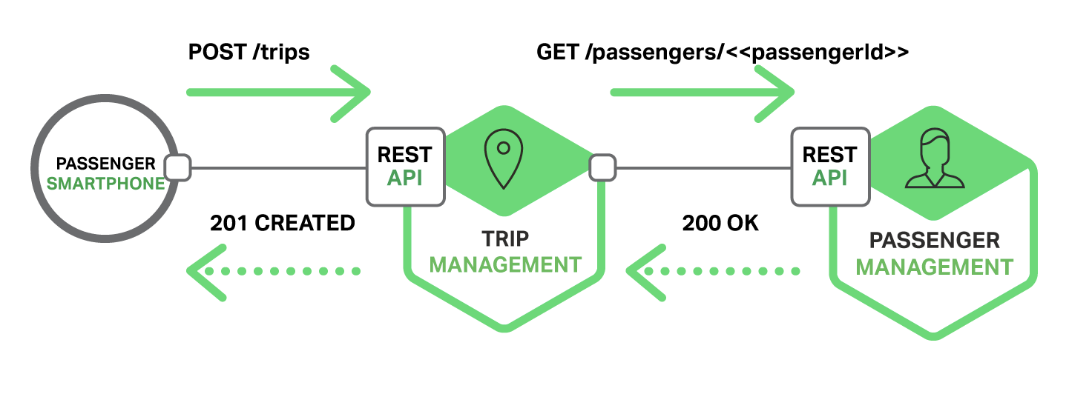
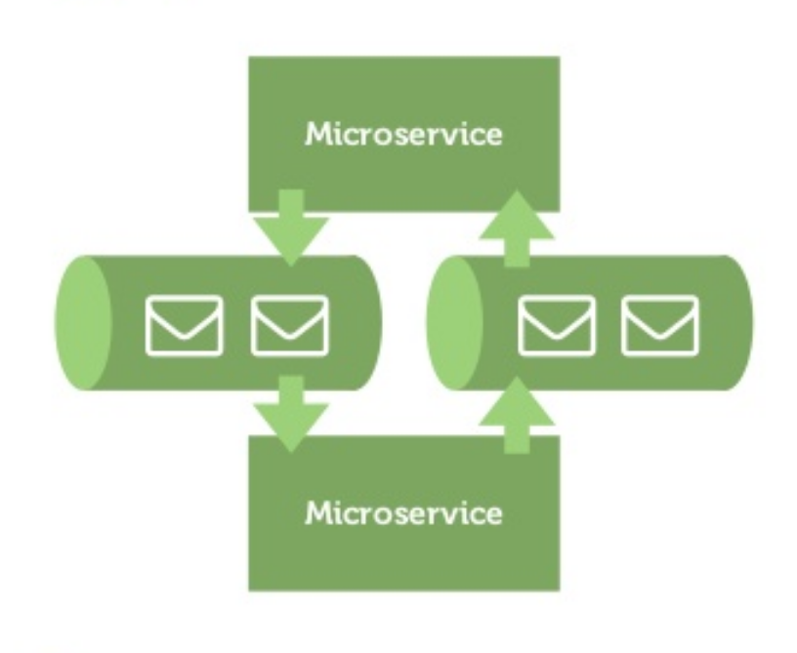
How do the services talk?
Services can talk synchronously as well as asynchronously.
Synchronous: e.g. REST based
Asynchronous:
e.g. Messaging based

Slide 15
This can’t be perfect! Tell me the downs now!
Developing distributed systems can be complex. Since everything is now an independent service, you have to carefully handle requests traveling between your modules.
Transaction management can be painful.
Testing a microservices-based application can be cumbersome.
Deploying microservices can be complex.

Slide 16
I’ve got this! What are my weapons?
Any general-purpose programming language and related data persistence strategy.
A communication medium for your services.

Slide 17
Q & A

